Slide 1
a
a
R
EU ETS Strategy of Compliance Webinar
Giovanna Carosi RINA Marine Rules and Regulation

Slide 2
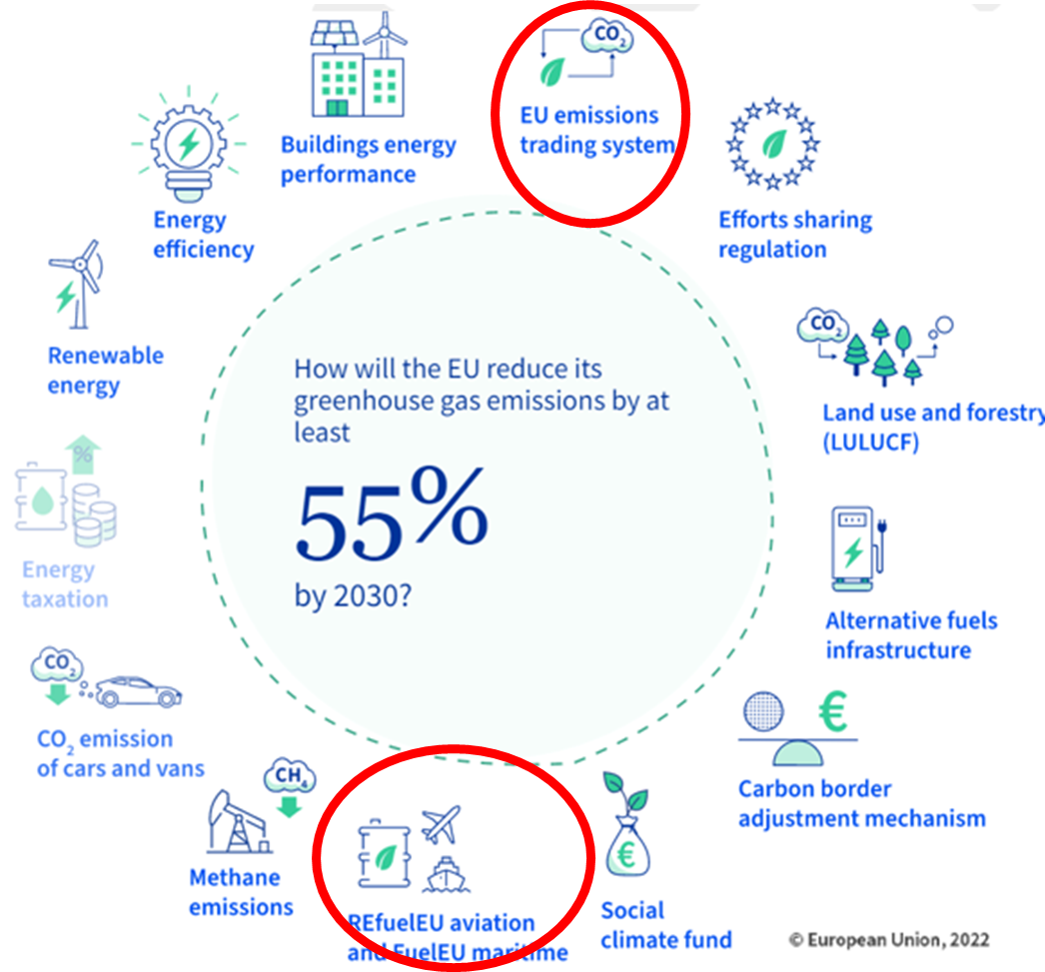
EU Decarbonization Requirements
Fit for 55

Slide 3
EU Decarbonization Requirements (MRV and ETS)
Key dates
01/10/23
01/01/24
01/04/24
01/01/25
06/06/25
01/01/26
01/01/27
MRV Monitoring Plan
Delegated Acts adopted
Assessed by Verifier
Submit to a. authority
Approved by a. authority
ETS Emission report prev. year submission
28/2 31/3
30/6 D.o.C.
30/9 EUA
28/2 31/3
30/6 D.o.C.
30/9 EUA
28/2 31/3
30/6 D.o.C.
30/9 EUA
Cargo/passenger ships ≥ 5.000GT
Reporting CO₂ only in MRV
CO₂ in ETS, CH₄ and N₂O reporting in MRV
GHG included in ETS scope
Offshore≥ 400GT, Gen.cargo 400-5.000 GT
Reporting CO_{2,} CH₄ and N₂O in MRV
Offshore ships ≥ 5000GT included in ETS scope
40%
70%
100%
100%
% emissions in ETS

Slide 4
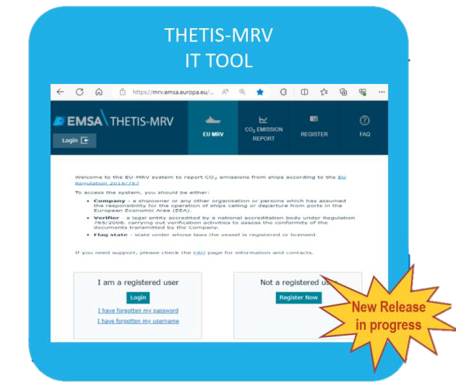
Implementation of MRV Reg. and Dir. ETS
MRV monitoring plan
MRV monitoring plan to be updated using the electronic version available in the Thetis MRV database from Jan. 2024
Part B -Basic Data
IMO unique Company and Registered owner identification number
Calculation for CO2 : Updated in view of new table of emission factors
Calculation of CH4 and N2O: New method
Procedure used to determine the CO2 emission factors of biofuels and RFNBOs/RCFs – if applicable
Part E -Management
Procedure for data flow activities
https://mrv.emsa.europa.eu/#public/faq
https://emsa.europa.eu/thetis-mrv/thetis-mrv-videos/

Slide 5
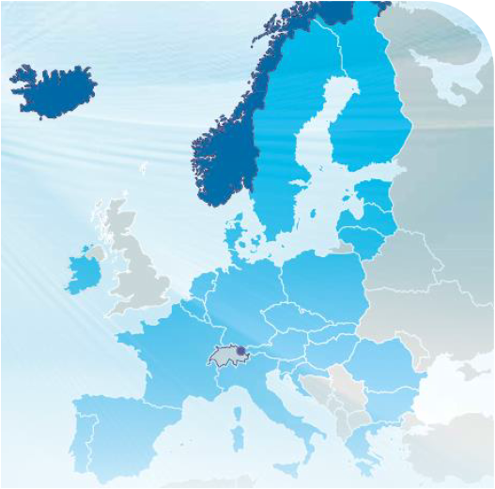
Implementation of MRV Reg. and Dir. ETS
Application
Application of the ETS Directive
Ships ≥ 5.000GT from 1 January 2024 and Offshore ships ≥ 5.000GT from 1 January 2027.
In relation to:
100% of the emissions within EU ports and from voyages between EU ports
50% of the emissions from voyages to or from EU ports, departing from or arriving at non-EU ports
Emissions to be counted
CO₂ from 1 January 2024
Methane CH₄ nitrous oxide N₂O from 1 January 2026
100%
50%
100%
50%

Slide 6
Implementation of MRV Reg. and Dir. ETS
“Port of call”
“port of call” means the port where a ship stops to load or unload cargo or to embark or disembark passengers, or the port where an offshore ship stops to relieve the crew;
stops for the sole purposes of refuelling, obtaining supplies,relieving the crew of a ship other than an offshore ship,
going into dry-dock or making repairs to the ship, its equipment, or both,
stops in port because the ship is in need of assistance or in distress,
ship-to-ship transfers carried out outside ports,
stops for the sole purpose of taking shelter from adverse weather or rendered necessary by search and rescue activities, and
stops of containerships in a neighbouring container transhipment port (see List)
are excluded
https://climate.ec.europa.eu/eu-action/transport/reducing-emissions-shipping-sector/faq-monitoring-reporting-and-verification-maritime-transport-emissions_en#voyages-and-ports-of-call
https://climate.ec.europa.eu/eu-action/transport/reducing-emissions-shipping-sector/faq-maritime-transport-eu-emissions-trading-system-ets_en

Slide 7
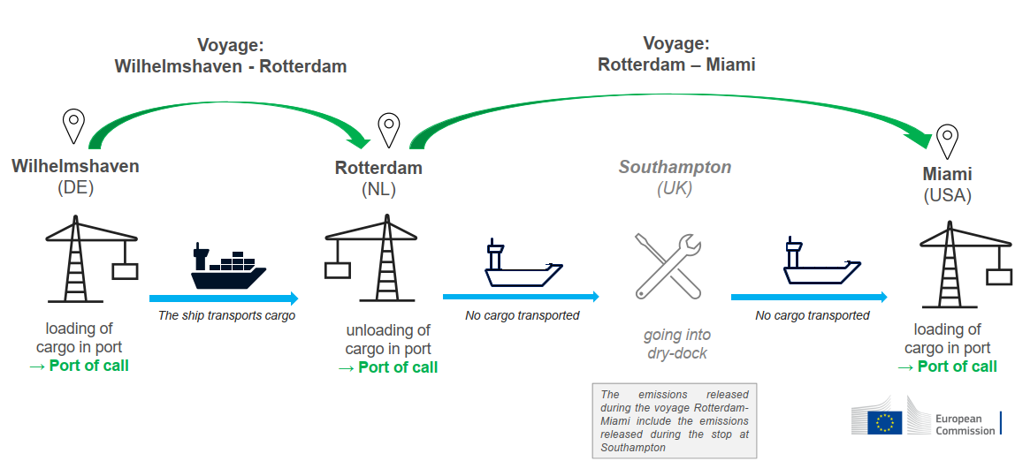
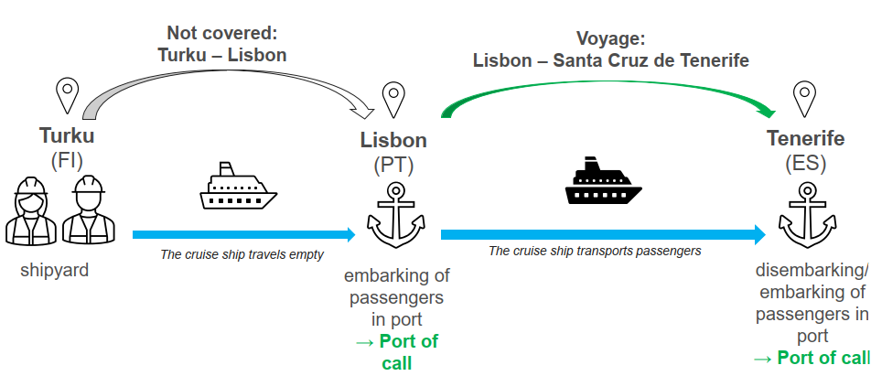
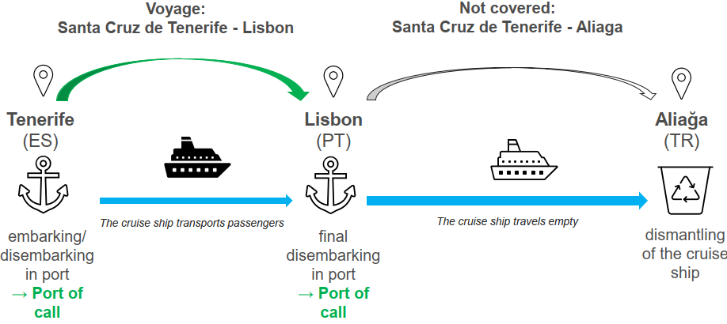
Implementation of MRV Reg. and Dir. ETS
DG CLIMA Clarifications on voyages/emissions
Dry-dock
Maiden voyage
Decomissioning voyage

Slide 8
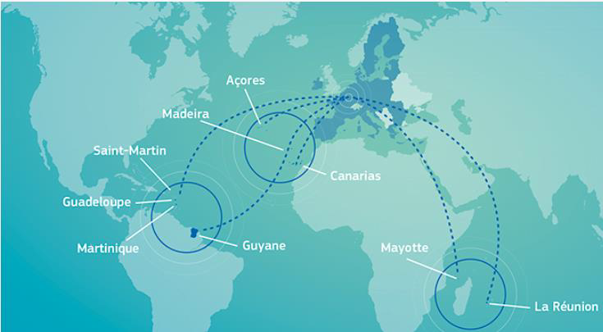
Implementation of MRV Reg. and Dir. ETS
Derogations
❑Ice class ships (IA or IA Super)
to surrender 5% fewer allowances until
31 December 2030
❑Derogation: until 31 December 2030,
emissions excludedfrom voyages by:
•passenger ships, other than cruise
passenger ships, and by ro-ro
passengerships,to/fromportsofEU
islandswithpermanentpopulationof
lessthan200.000residents
•passengerorro-ropassengerships
performed under a transnational
publicservicecontract/obligation
•shipsto/fromEUoutermostregion
from/toaportofthesameEUMSState
(includingportswithinandbetweenthe
outermostregionsofthesameMS)

Slide 9
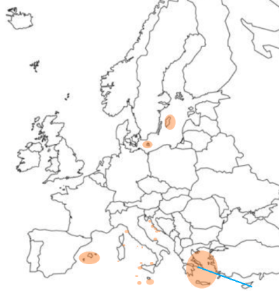
Implementation of MRV Reg. and Dir. ETS
Derogations
List of ports of small islands (less than 200.000 residents) and transnational public service contract/obligation

Slide 10
Implementation of MRV Reg. and Dir. ETS
Acts
Rules on monitoring and reporting of GHG emission for shipping companies under the ETS
Rules on aggregated emissions data at shipping company level
Approval and verification activities and accreditation of verifiers
Templates

Slide 11
Implementation of MRV Reg. and Dir. ETS
Exclusions
Compliancewith the
sustainability criteria and
GHGsaving criteria
established by RED Dir.
Biofuel Biogas
EU ETS Directive
C_{f} the biomass for
CO₂=0
COMMISSION DELEGATED ACT ON REVISED MRV
1.2 Derogation from the general principle and use of emission factors pursuant to Article 14 of Directive 2003/87/EC
By way of derogation from point 1.1, companies shall not apply the rules laid down in Part A of Annex I to this Regulation
as regards the determination of the CO₂ emission factors where the company uses a fuel complying with the
sustainability criteria and greenhouse gas emission saving criteria for the use of biomass established by
Directive (EU) 2018/2001 of the European Parliament and of the Council, with any necessary adjustments for
application as set out in Implementing Regulation (EU) 2018/2066. In such cases, the CO₂ emission factor of the
biomass fraction of the fuel shall be zero.
By way of derogation from point 1.1, companies shall not apply the rules laid down in Part A of Annex I to this Regulation
as regards the determination of the CO₂ emission factors where the company uses Renewable Fuels of Non-Biological
Origin (RFNBO) and Recycled Carbon Fuel (RCF). In such cases, the CO2 emission factor shall be determined in
accordance with Implementing Regulation (EU) 2018/2066.

Slide 12
Implementation of MRV Reg. and Dir. ETS
Acts
ETS neighbouring container transhipment ports
EAST PORT SAID - EGYPT
TANGER MED - MOROCCO
Rules for the administration of shipping companies by administering authorities under ETS
ENTITY RESPONSIBLE FOR ETS
CRITERIA TO ASSIGN THE ADMINISTERTING AUTHORITY

Slide 13
Implementation of MRV Reg. and Dir. ETS
Adminstering Authority
Shipping
Company
Information gathered from Thetis MRV
Registered in
a EU/EEA MS
NOT
Registered in
a EU/EEA MS
Voyages in
EU I the last 4
years
EU/EEA MS
with the
greatest
number of
port calls in
the last 4
years
NOT
performing
voyages in
EU
Information gathered from EU
vessel traffic monitoring and
information system
EU/EEA MS
EU/EEA MS
of the first
port of call

Slide 14
For more info:
a
a
Thank you for your attention
Giovanna Carosi
giovanna.carosi@rina.org

